Slide 1
Constraint Propagation

Slide 2
Visuospatial Reasoning
Constraint Propagation
Visuospatial Reasoning

Slide 3
Lesson Preview
Definition
Image processing
Natural language understanding
Advanced problems

Slide 5
Which of these wireframes depicts a 3D figure that could exist in the real world?
ο
ο
ο
ο
ο
ο

Slide 6
Which of these sentences are grammatically correct?
ο Colorless green ideas sleep furiously.
ο Soft drinks due from thank bills insurance.
ο The treating physician persons the following excluded tasty.
ο Wall decor notifies business cards of nonsensical whims.
ο Tuesday brought a sharp-edged suite of pumpernickel.
ο Go search or revoke to writing this present understand.

Slide 7
Constraint propagation: a method of inference that assigns values to variables characterizing a problem in such a way that some conditions (called constraints) are satisfied.
Colorless green ideas sleep furiously.

Slide 8
Pixels
Lines

Slide 9
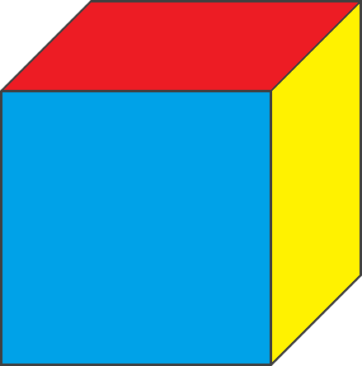
Lines
Surfaces

Slide 10
Surfaces
3D

Slide 11
Lines
Surfaces

Slide 13
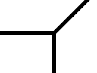
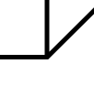
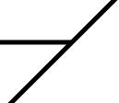
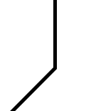
Constraints
Y-Constraint
W-Constraint
L-Constraint
T-Constraint

Slide 14
Constraints
Y-Constraint
W-Constraint
fold
fold
fold
blade
fold
blade
L-Constraint
T-Constraint
blade
blade
blade
fold
blade

Slide 15
Label each intersection according to the applicable constraint on the right.
1
6
L
W
Y-Constraint
W-Constraint
W
Y
2
4
L-Constraint
T-Constraint
7
L
3
5
L
W

Slide 16
Label each line according to the constraint on the right.
5
1
blade
blade
Y-Constraint
W-Constraint
fold
2
6
fold
fold
8
fold
fold
blade
blade
blade
fold
3
blade
7
L-Constraint
T-Constraint
fold
9
blade
blade
blade
blade
blade
fold
blade
4

Slide 17
Y-Constraint
W-Constraint
fold
fold
fold
blade
fold
blade
L-Constraint
T-Constraint
blade
blade
blade
fold
blade

Slide 18
Y-Constraint
W-Constraint
fold
fold
fold
blade
fold
blade
L-Constraint
T-Constraint
blade
blade
blade
fold
blade

Slide 19
Y-Constraint
W-Constraint
fold
fold
fold
blade
fold
blade
L-Constraint
T-Constraint
blade
blade
blade
fold
blade

Slide 20
L
Y-Constraint
W-Constraint
fold
fold
fold
blade
fold
blade
Y
L
L-Constraint
T-Constraint
blade
blade
blade
fold
blade

Slide 21
L
blade
blade
Y-Constraint
W-Constraint
fold
fold
fold
blade
fold
blade
Y
L
blade
L-Constraint
T-Constraint
blade
blade
blade
blade
fold
blade

Slide 22
L
blade
blade
Y-Constraint
W-Constraint
fold
fold
fold
blade
fold
blade
Y
L
fold
fold
blade
fold
L-Constraint
T-Constraint
blade
blade
blade
blade
fold
blade

Slide 23
L
blade
blade
Y-Constraint
W-Constraint
fold
fold
fold
blade
fold
blade
Y
L
fold
fold
blade
fold
L-Constraint
T-Constraint
blade
blade
blade
blade
fold
blade

Slide 24
Y-Constraint
W-Constraint
fold
blade
fold
blade
fold
blade
blade
fold
fold
blade
blade
fold
L-Constraint
blade
fold
blade
fold
blade
fold
fold
blade

Slide 25
Colorless green ideas sleep furiously.
Noun Phrase
Verb Phrase
Colorless green ideas
sleep furiously.
Adjectives
Noun
Verb
Adverb
Colorless green
ideas
sleep
furiously
Constraints:
Sentence = Noun Phrase + Verb Phrase
Noun Phrase = [Adjectives] + (Noun or Pronoun)
Verb Phrase = Verb + [Adverb]

Slide 26
Soft drinks due from thank bills insurance.
Constraints:
Sentence = Noun Phrase + Verb Phrase
Noun Phrase = [Adjectives] + (Noun or Pronoun)
Verb Phrase = Verb + [Adverb]

Slide 27
Assignment
How would you use constraint propagation to design an agent that could answer Raven’s progressive matrices?

Slide 28
To recap…
Definition
Image processing
Natural language understanding
Advanced problems

